Slide 1

SRI INDU COLLEGE OF ENGINEERING AND TECHNOLOGY DEPARTMENT OF ELECTRONICS AND COMMUNICATION ENGINEERING BATCH:2020-2024
Fake Currency Detection Using Machine Learning
Team Members:
Tallada Sai Sharan - 20D41A04K5
Katta Sri Lakshmi Prasanna - 21D45A0420
Shaik Mohammed Aleemuddin - 20D41A04J4
Allamla Srikanth - 18D41A0409

Slide 2
Contents:
Abstract
Introduction
Existing System
Proposed System
Block diagram
The Model Architecture
Conclusion

Slide 3
Abstract:
In our project, we focus on the detection of fake currency. The primary machine learning algorithm used in this project is not a traditional supervised learning algorithm, but rather image processing techniques and correlation analysis.Our system processes currency images ,extracting key features using grayscale and HSV colour analysis. By evaluating correlations and examining components, it accurately distinguishes real transparent elements, ensuring accurate detection of counterfeit currency. It effectively distinguishes between genuine and counterfeit banknotes. By extracting relevant features from banknote images, the system learns to make accurate predictions. The project aims to contribute to the prevention of financial fraud by providing a reliable method for identifying fake currency notes.

Slide 4
Introduction:
Our project, title “Fake Currency Detection Using Machine Learning’’ aims to tackle the problem of counterfeit currency. With this Machine Learning Project, we will be building a fake currency detection system for detecting fake currency and real currency. In today’s time, the production and circulation of inauthentic currency notes have been increasingly sophisticated. That’s why there needs to be a system to check whether a currency is fake or real.

Slide 5
Existing System:
Right now, the ways we detect fake money have some problems. The methods we use
are old and can't handle new fake money tricks very well. This makes it hard to tell if
a note is real or fake. We need new and smart solutions that can change and improve
as fake money methods change.

Slide 6
Proposed System:
Our proposed system utilizes primary Machine Learning algorithms. By analyzing currency images, our system can distinguish between real and fake notes quickly and accurately. This approach enhances the efficiency of counterfeit detection, ensuring a reliable method to safeguard financial transactions and maintain the trustworthiness of currency circulation.

Slide 7
Block Diagram:
Image Acquisition
RGB to GRAYSCALE
Segmentati0n
Classification
Finding Correlation
Feature Measurement

Slide 8
Explanation:
Image Acquisition: The image is provided to the model. There should be two images – a note which you want to detect and a corresponding real note.
RGB to GRAYSCALE: The RGB image is converted into a GRAYSCALE image.
Segmentation: The image is segmented to crop Gandhi Ji image and thin strip image.
Feature Measurement: Feature measurement is done to measure the number of lines on a thin strip. This is a really lengthy process.
Finding Correlation: We find a correlation between Gandhi Ji’s image on the original note and a fake note. If the result is greater than 0.5 then we will consider it legitimate otherwise the currency is fake.
Classification: Finally, we will classify the image as real or fake.

Slide 9
The Model Architecture:
This model we will build will use a grayscale image, segmentation, and feature extraction .We are going to use OpenCV in this project because this library contains some of the pre-built functions to work with images. To check whether the currency is fake or real, we will take a real note and a fake note as input an image in the system. The input images given to the system will be converted into grayscale images. We will use segmentation to segment out the image of Gandhi Ji and the thin strip on the note.
The idea is that we will compare the real and fake notes based on the image of Gandhi Ji and the thin strip present on the image. We will compare the image of Gandhi Ji and we will check whether the number of lines in the thin strip is equal to the number of lines in the thin strip.

Slide 10
The comparison of Gandhi Ji’s image is simple because we just have to find a correlation between two images using a correlation function. If the result of the correlation function is greater than 0.5 then Gandhi Ji is legitimate and we will check for a thin strip. Otherwise, the note is fake.
Now the main problem is to find the number of lines in thin strips. For that, we will convert the image into HSV(hue saturation value) image because it will be easy that way. Then we will segment the image to find the thin strip. After that, we will apply a bwlabel function to find the number of connected components i.e. the number of lines in the thin strip.

Slide 11
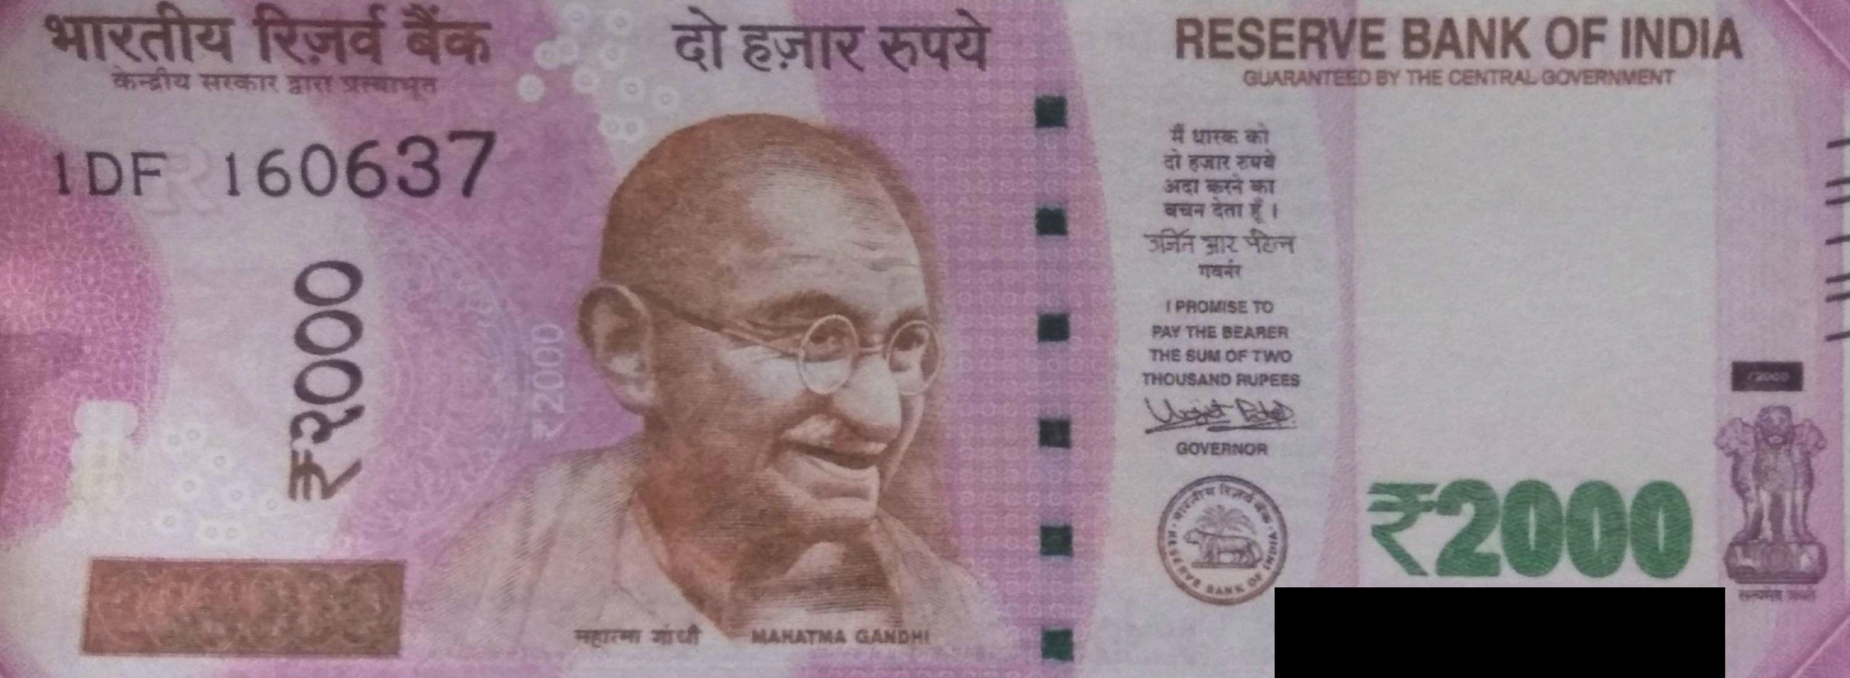
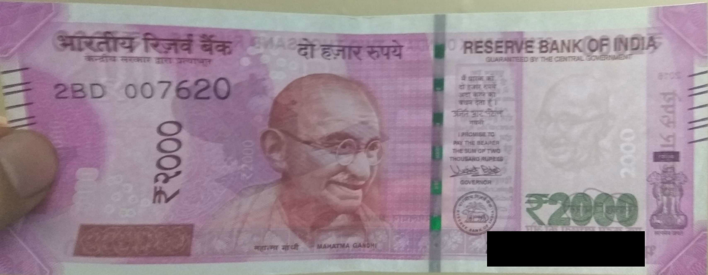
Images that we used in our project:
Fake
Real

Slide 12
Conclusion:
In conclusion, our project represents a significant step forward in the fight against
counterfeit currency. By using the power of machine learning and Python
programming, we have developed a robust system capable of accurately detecting
fake notes. This technology not only enhances financial security but also contributes
to advancements in the field of machine learning. Our work holds great potential for
real-world applications and demonstrates the positive impact of technology on
society's challenges.

Slide 13
THANK YOU

